Slide 1
Module-2
Water Treatment
Topics: Water softening methods: - Lime-soda, Zeolite and ion exchange processes and their applications. Specifications of water for domestic use (ICMR and WHO); Unit processes involved in water treatment for municipal supply - Sedimentation with coagulant- Sand Filtration - chlorination; Domestic water purification – Candle filtration- activated carbon filtration; Disinfection methods - Ultrafiltration, UV treatment, Ozonolysis, Reverse Osmosis; Electro dialysis.

Slide 2
Water Softening methods
The process of removing the hardness producing substance from the water is called softening of water
In Industry three main methods are employed for softening of water
Lime soda process: lime Ca(OH)₂ and soda Na₂CO₃ is added; (residual hardness: 15 to 60 ppm)
Zeolite (permutit) process: Hard water is filtered through a natural sand called the zeolite (residual hardness: up to10 ppm)
Ion-exchange and Mixed bed ion-exchange process:
Cation exchange resins (RH⁺)
Anion exchange resins (R’OH⁻)
Mixed bed ion-exchange

Slide 3

Permutit or Zeolite Process
Zeolite is hydrated sodium aluminium silicate having a general formula, Na₂OAl₂O₃.xSiO₂.yH₂O. (x=2 to 10 and y=2 to 6 )
It exchanges Na⁺ ions for Ca²⁺ and Mg²⁺ ions.
Common Zeolite is Na₂OAl₂O₃.3SiO₂.2H₂O known as natrolith.
Other gluconites, green sand (iron potassium phyllosilicate with characteristic green colour, a mineral containing Glauconite)etc. are used for water softening.
Artificial zeolite used for water softening is Permutit.
These are porous, glassy particles having higher softening capacity compared to green sand.
They are prepared by heating china clay (hydrated aluminium silicate), feldspar (KAlSi₃O₈-NaAlSi₃O₈ – CaAl₂Si₂O₈) are a group of rock-forming tectosilicate minerals which make up as much as 60% of the earth’s crust) and soda ash (Na₂CO₃)

Slide 4
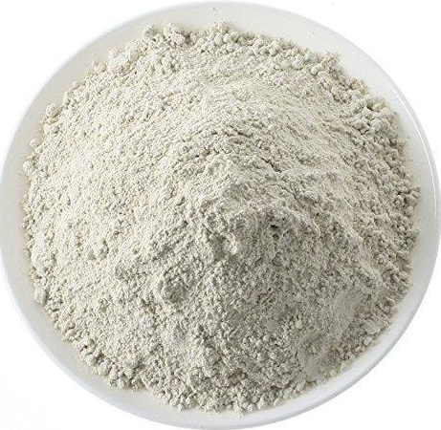
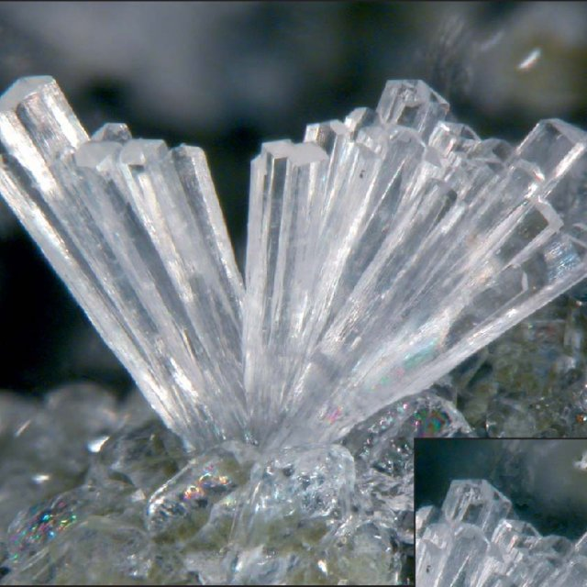
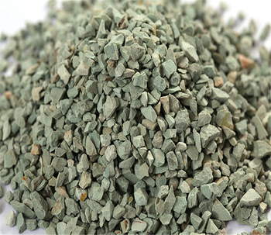
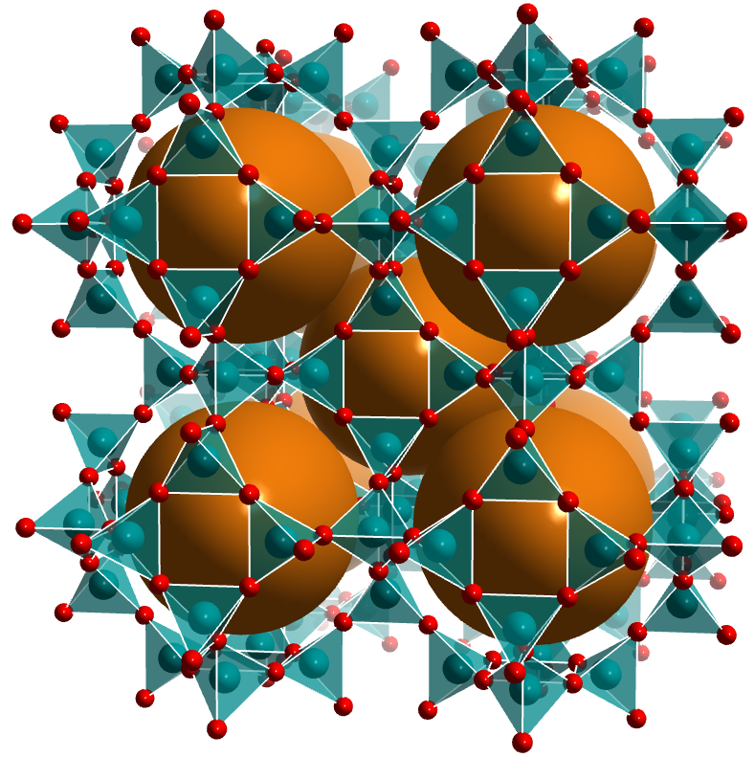
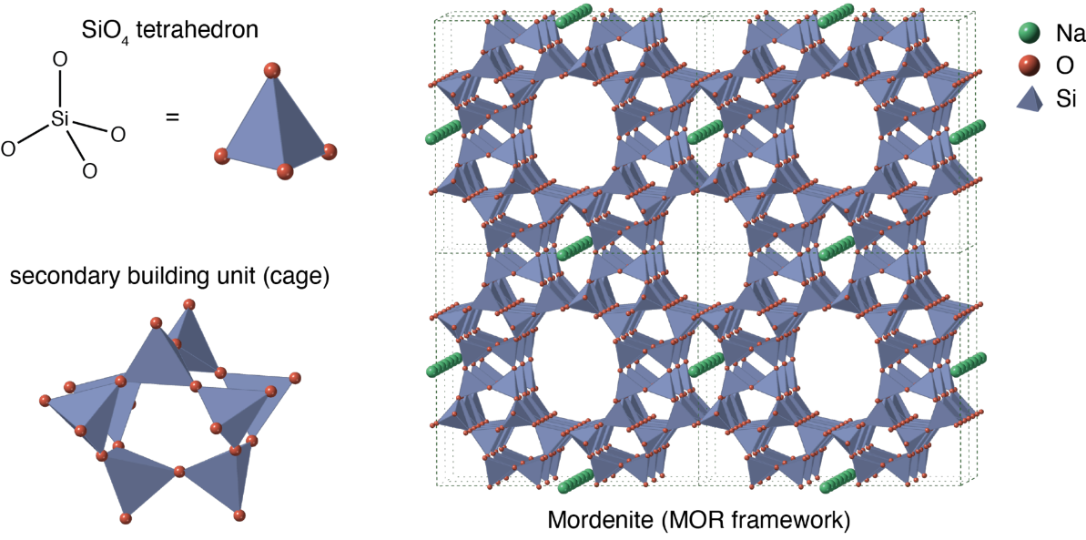


Slide 5
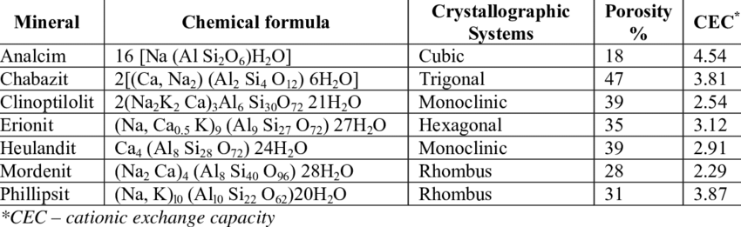

Types of zeolite
Natural Zeolites:
Natrolite: Na₂O.Al₂O₃.4SiO₂.2H₂O
Laumontite: CaO. Al₂O₃.4SiO₂.4H₂O
Harmotome: (BaO.K₂O).Al₂O₃.5SiO₂.5H₂O
They are capable of exchanging its Na ions.
These are less porous, amorphous and durable

Slide 6


Zeolite process
For softening of water by zeolite process, hard water is percolated at a specified rate through a bed of zeolite, kept in a cylinder. Zeolite holds sodium ions loosely and can be represented as Na₂Ze. Where Ze = insoluble radical frame work.
The hardness causing ions(Ca²⁺, Mg²⁺) are retained by the zeolite as CaZe and MgZe respectively, while the outgoing water contains sodium salts. During this process, the water becomes free from Ca²⁺ and Mg²⁺ ions.
Method of softening:
Na₂Ze + Ca(HCO₃)₂ 2 NaHCO₃ + CaZe
Na₂Ze + Mg(HCO₃)₂ 2 NaHCO₃ + MgZe
Na₂Ze + CaSO₄ 2 Na₂SO₄ + CaZe
Na₂Ze + CaCl₂ 2 NaCl + CaZe

Slide 7
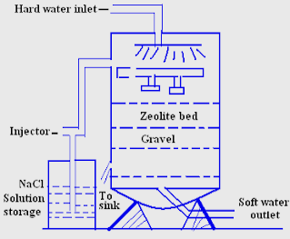
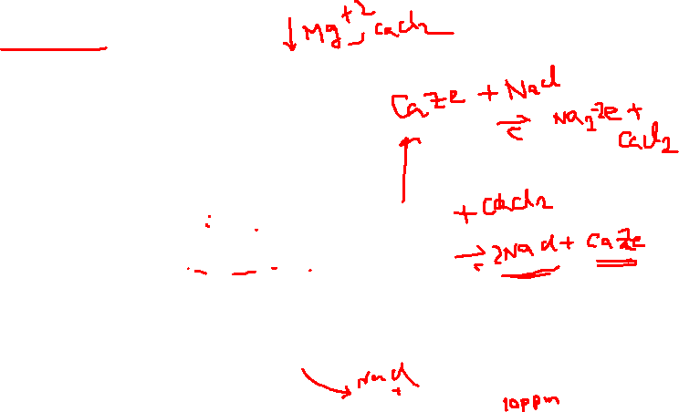
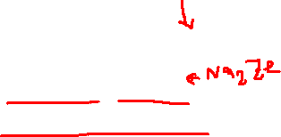
Zeolite Process Diagram

Slide 8

Regeneration:
After some time, the zeolite is completely is completely converted into calcium and magnesium zeolite and it ceases to soften water, i.e., it gets exhausted.
At this stage, the supply of hard water is stopped and the exhausted zeolite is reclaimed by treating the bed with a concentrated (10%) brine (NaCl) solution.
The washing (containing CaCl₂ and MgCl₂ ) are led to drain and the regenerated zeolite bed thus-obtained is used again for softening purpose.
CaZe + 2 NaCl → CaCl₂ + Na₂Ze
MgZe + 2 NaCl → MgCl₂ + Na₂Ze
(Brine solution)

Slide 9
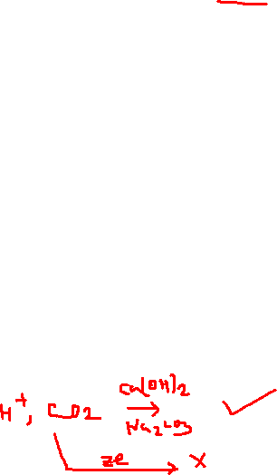
Zeolites
Advantages:
Residual hardness of water is about 10 ppm only
Equipment is small and easy to handle
Time required for softening of water is small
No sludge formation and the process is clean
Zeolite can be regenerated easily using brine solution
Any type of hardness can be removed without any modifications to the process
Disadvantages:
Coloured water or water containing suspended impurities cannot be used without filtration
Water containing acidic pH cannot be used for softening since acid will destroy zeolite.

